Slide 1
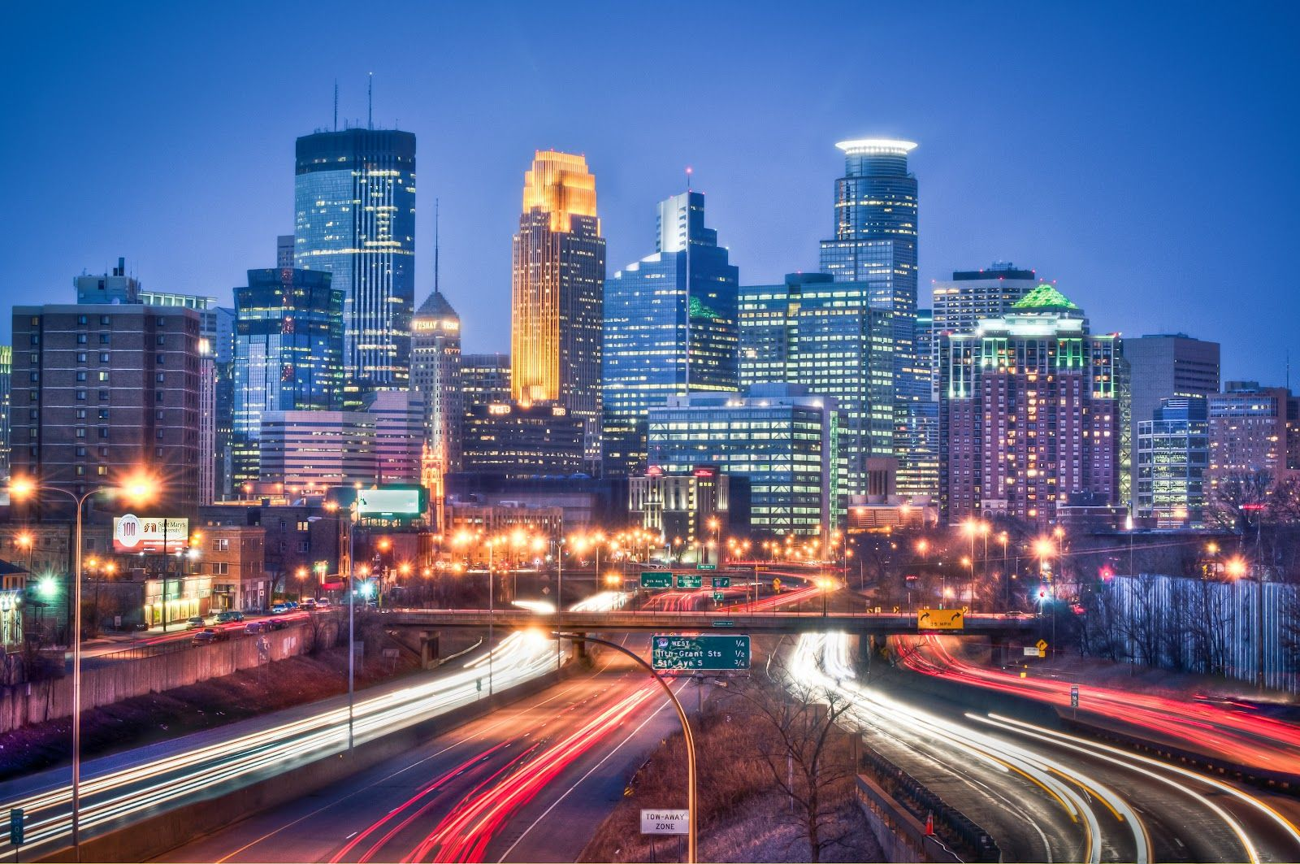
Crime and Weather Comparison
MINNEAPOLIS

Slide 2
Hypothesis: Temperature and weather will affect rates of crime.
Temperature vs Violent Crime
As the temperature increases, will rates of violent crime will also increase?
Adverse weather vs Non-Violent Crime
After major weather events (i.e., tornados, blizzards, floods) will nonviolent crime increase?
Weather and demographics
Will temperature affect crime rates by gender and age differently?
Weather and officer staffing
Is there a correlation between temperature and Officer staffing levels?

Slide 3
Data Sources
worldweatheronline.com
CSV of historical weather data
opendata.minneapolismn.gov
CSV of historical crime data in Minneapolis
api.data.gov
FBI crime statistics API

Slide 4
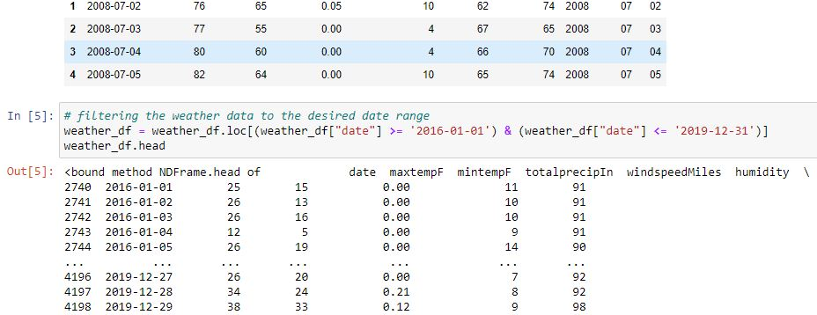
Data Clean-up and Analysis for Temperature vs Violent Crime
Jupyter Notebook

Slide 5
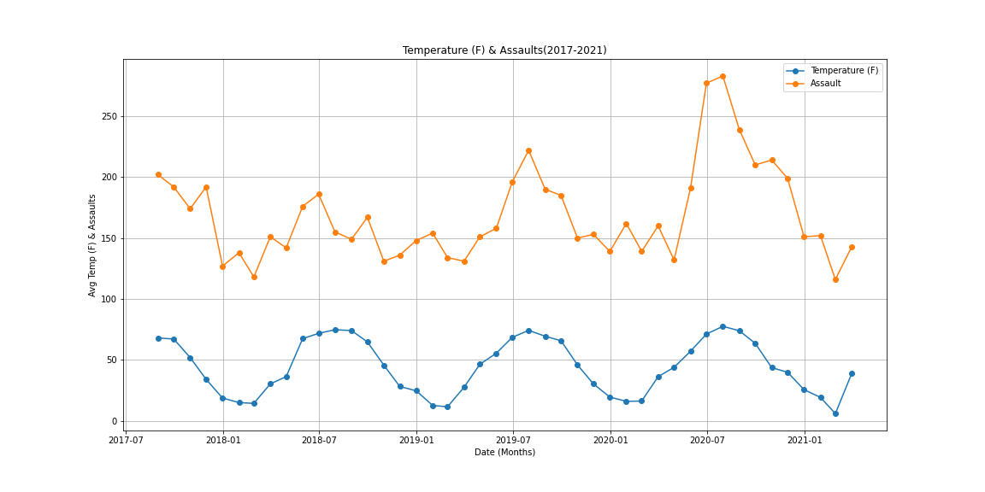
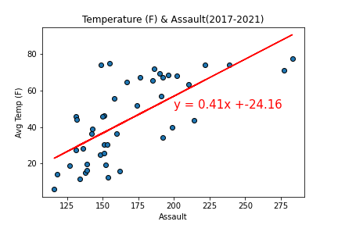
Temperature vs Assault The r-value is: 0.48314455698691894

Slide 6
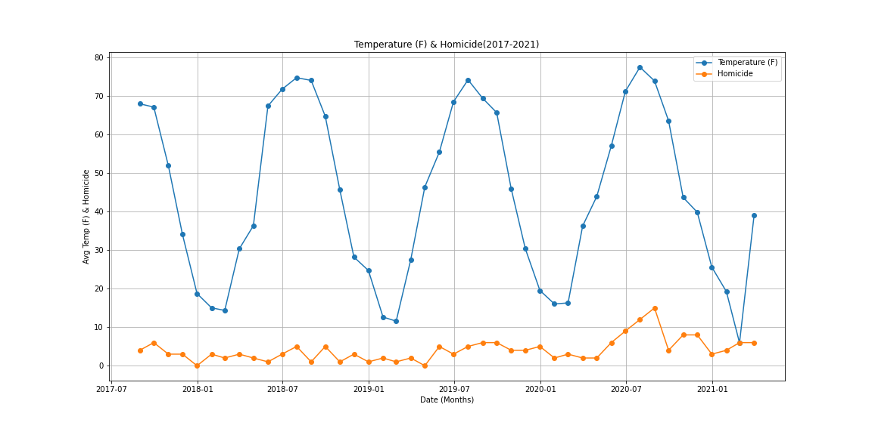
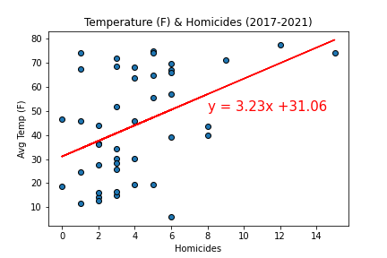
Temperature vs Homicide The r-value is: 0.18790837713090577

Slide 7
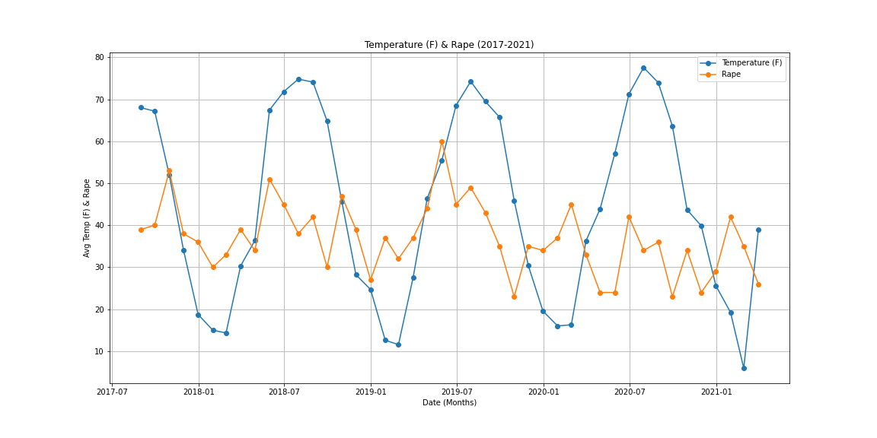
Temperature vs Assault The r-value is: 0.06974819074317856

Slide 8
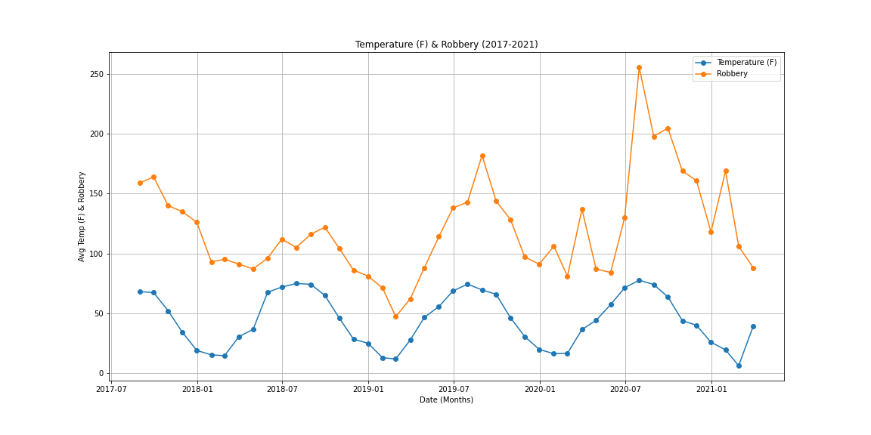
Temperature vs Assault The r-value is: 0.30462164827108484

